Slide 1
TE 271: Analog Communication Systems Lecture 4 Examiner: M. S. Ellis, PhD smellis.coe@knust.edu.gh 057 904 7591
September 27th , 2016

Slide 2
Reference material
A. Yadav, “Analog Communication Systems”, University Science Press, New Delhi, 2008.
S. Sharma, “Communication Engineering”, First Ed., S.K. Kataria & Sons, New Delhi, 2011.
T. G. Thomas, “Analog Communication”, McGraw hill, New Delhi, 2007.

Slide 3
Side Band Techniques
The equation for an AM wave is given by:
V = Vc cosωct + maVc/2 cos(ωc + ωm)t + maVc/2 cos(ωc - ωm)t….….(10)
Purpose of modulation is to send the weak message signal with the help of a carrier, NOT to send the carrier
Now, the carrier can therefore be removed without affecting the net content of the information. This is known as suppressed carrier (SC)

Slide 4
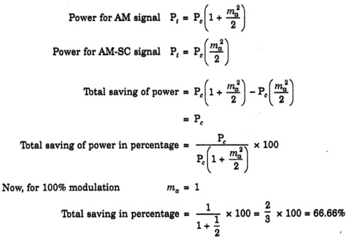
This will also require less power without affecting the net content of the information Proven below as;
By removing the carrier, 66.66% of the total power can be saved without affecting the net content of information

Slide 5
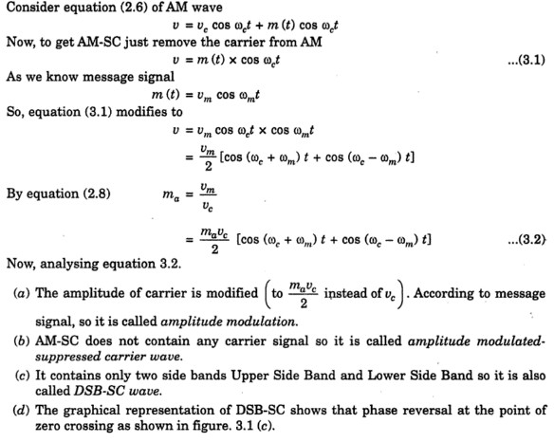

Slide 6
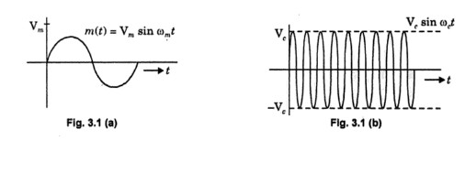
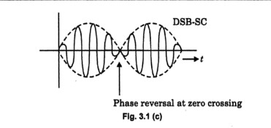
REPRESENTATION OF AM-SC WAVE

Slide 7
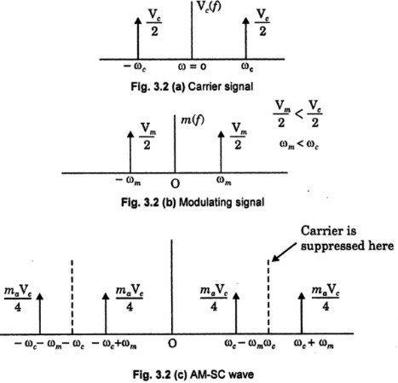
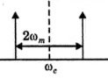
SPECTRUM OF AM-SC WAVE
Only positive freq for practical use

Slide 8
Generation of DSB-SC
Methods of generation a suppressed carrier AM wave is the same as discussed in generation of an AM wave, i.e.
Linear Time Variant Circuit
Non-Linear Circuit
Similarly, an example of a linear time variant circuit for DSB-SC generation is a chopper circuit (also called switching circuit or ring modulator) ……. Refer from Lecture 3
Likewise, an example of a non-linear circuit used to generate DSB-SC is a balanced modular is used to generate…….. Refer from Lecture 3

Slide 9
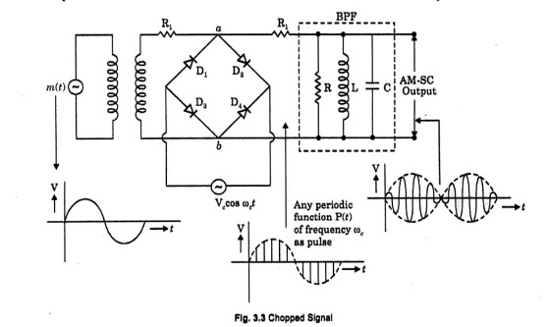
All diodes are in forward bias for positive half cycle of carrier signal. Therefore no signal across resistance R (input of BPF)
All diodes are in reverse bias so diodes acts as an open circuit. Therefore signal for negative cycle appears across resistance R (input of BPF)

Slide 10
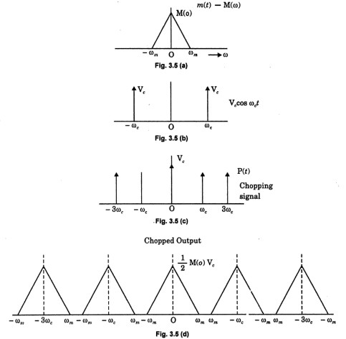
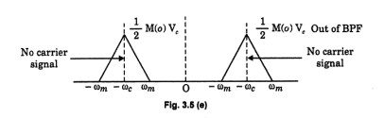

Slide 11
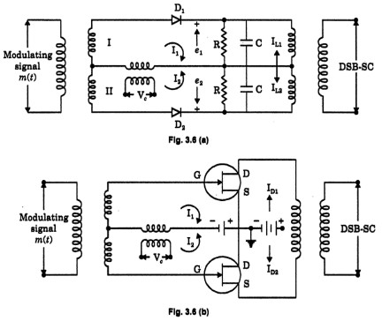
A balanced modulator (non-linear circuit) for DSB-SC modulation

Slide 12
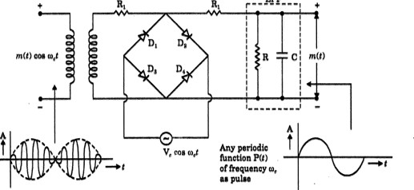
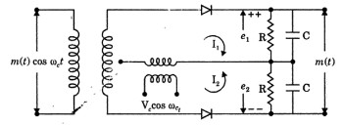
Demodulation of DSB-SC signal
Using Linear Time-Variant Circuit
Using Non-Linear Device

Slide 13
Single Side-Band (SSB) Transmission
As discussed earlier under DSB-SC, there is really no need to transmit the carrier
By doing so we can save power and maintain the same bandwidth as in the case of AM
V = maVc/2 [cos (ωm+ωc) t * cos (ωc-ωm)t] ....DSB-SC wave
The DSB-SC wave contains two identical sidebands
There is really no need to transmit both side bands if only one can be used to transmit the information
V = Vc cos ωct + maVc/2 [cos (ωm+ωc) t * cos (ωc-ωm)t]

Slide 14
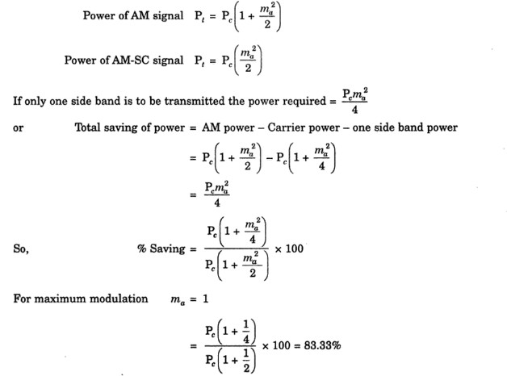
By transmitting a single side band signal (SSB), 83.33 % of the total power has been saved
Transmission bandwidth requirement also drops by half
Reduced noise
Reduced fading
Applications where SSB is used include ??

Slide 15
SSB Generation
DSB-SC Filtering Method: Since SSB modulation is the transmission of the upper or lower sideband, SSB can be generated by easily filtering the undesired side band of the DSB-SC signal
Filter bandwidth should equal to that of the message signal (not twice its bandwidth)
Center frequency of filter should equal to the center frequency of the desired side band (not carrier)
Setback: Filters with sharp edges do not exist. Non-sharp edges must be used. Adequate separation between side bands required

Slide 16
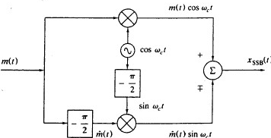
Phase-Shift Method: Here, the box marked -π/2 is a 90 degrees phase shifter that delays the phase of every frequency component by 90 degrees
At output XSSB(t) = m(t)cosωct ± m(t)sinωct
The difference represents LSB, and sum represents USB

Slide 17
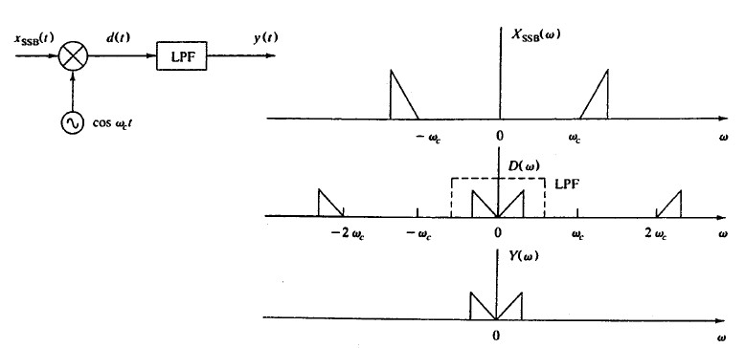
SSB Demodulation
The process for SSB demodulation is the same as that for a simple DSBSC demodulator.
Advantages of SSB Modulation ?
Disadvantages of SSB modulation ?

Slide 18
Vestigial Side Band (VSB) Modulation
As stated previously, SSB generation suffer some problems including filter sharpness problems AND ideal phase shifter design complications
A compromise between DSB-SC and SSB is known as Vestigial Side Band (VSB) modulation
Generation of VSB is similar to that of selective filtering for SSB

Slide 19
In certain applications, a DSB modulation technique takes too much bandwidth for the channel.
An SSB technique will take half the bandwidth of DSB but it’s also too expensive to implement
Therefore, a Vestigial Sideband is often chosen in this situation
A VSB signal is obtained by partial suppression of one of the sidebands of a DSB signal (AM or DSB-SC).
What system uses VSB Modulation ?

Slide 20
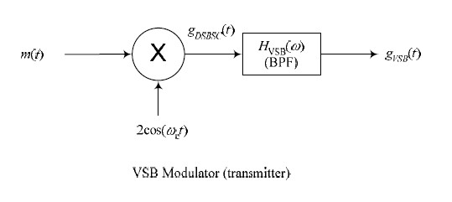
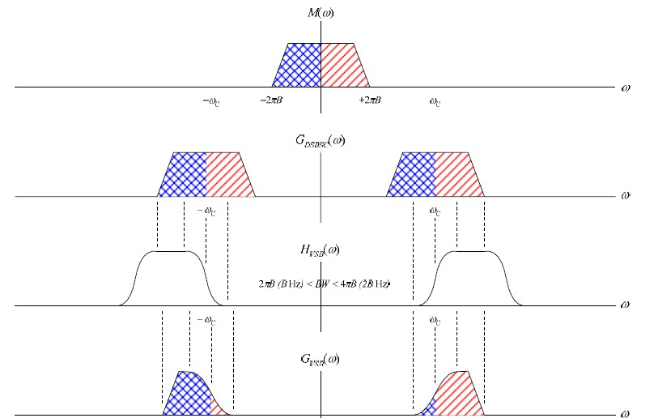
VSB Modulation

Slide 21
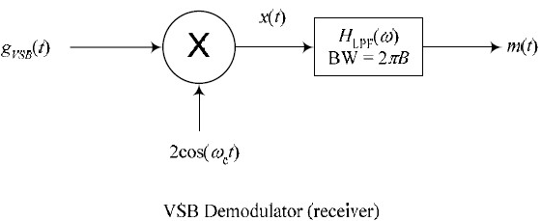
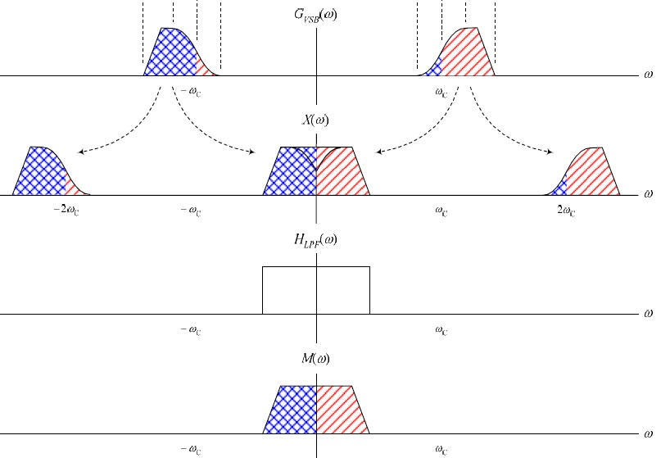
VSB Demodulation

Slide 22
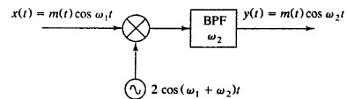
Frequency Translation and Mixing
In signal processing, it is desirable to translate the modulated signal frequency to a new frequency band.
A device that performs the frequency translation of a modulated signal is called a frequency mixer

Slide 23
Frequency Division Multiplexing
Multiplexing is a technique whereby several message signals are combined into a complex signal for transmission over a single channel
To achieve this, the signals must be kept apart so they do not interfere with each other within the common channel
Frequency division (FDM) and time division multiplexing (TDM) are the two basic multiplexing techniques

Slide 24
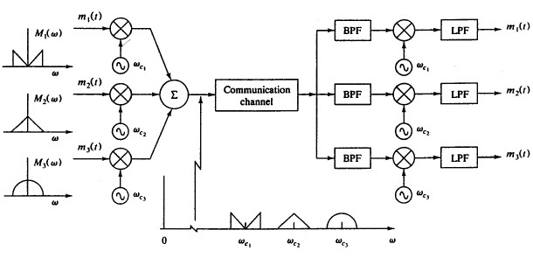
FDM
Simultaneous transmission of 3 signals
Spectra and sum of modulated frequencies illustrated
Band pass filters used to separate modulated signals before demodulation
FDM is used in telephone systems, television broadcast, telemetry..etc
What type of modulation is used here. DSB, VSB, or SSB ??

